Slide 1




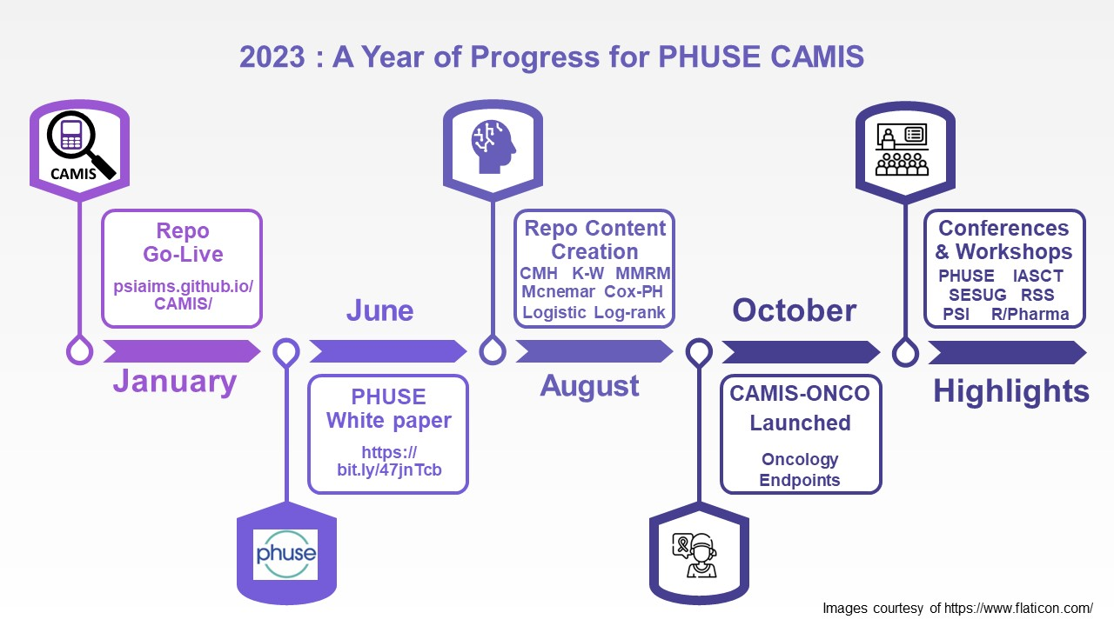

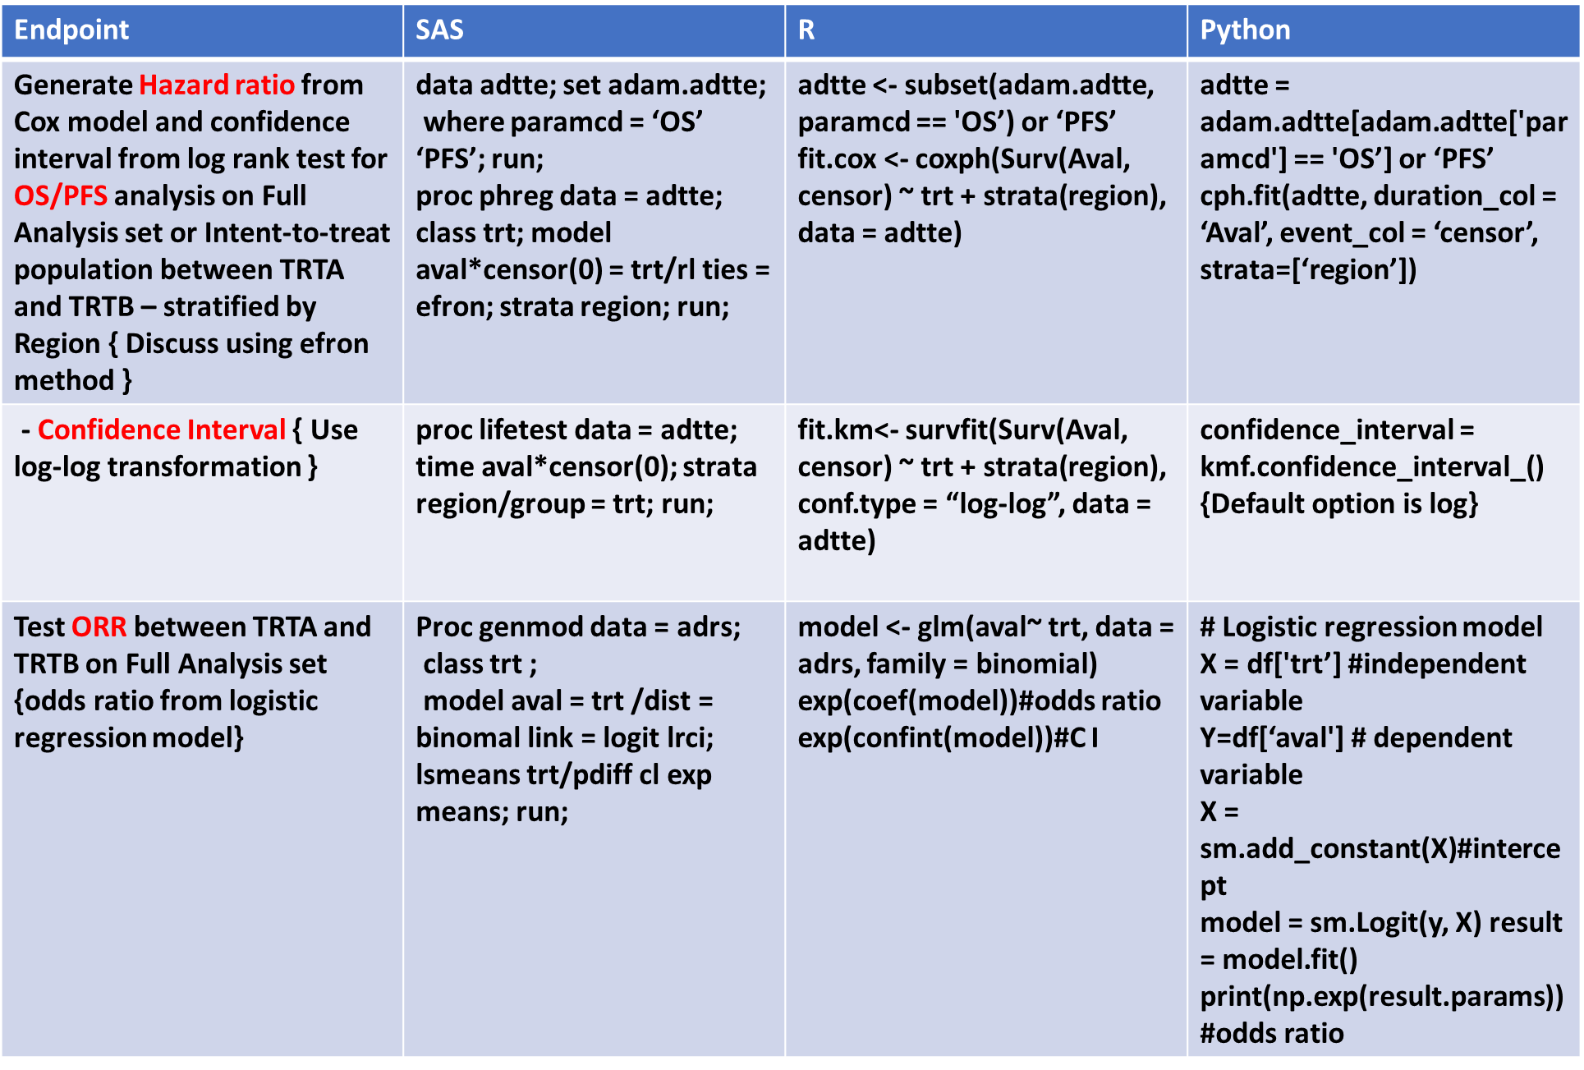


PP26
Comparing Analysis Method Implementations in Software (CAMIS): An open source repository to document differences in statistical methodology software
Soma Sekhar Sriadibhatla* (AstraZeneca): somasekhar.sriadibhatla@astrazeneca.com
Vikash Jain (Genpro Research): vikash.jain@genproresearch.com
CAMIS Working Group
Background:
Statisticians and programmers working in multiple software systems (e.g. SAS, R, Python), will have found differences in analysis results that warrant further exploration and justification. Whilst some industries, may accept results not being the same as long as they are “close” -- the more highly regulated medical research industry generally uses double programming to validate results. This approach requires an identical match in results. This can be very challenging and highly time consuming to investigate and justify any differences, particularly when accompanying documentation doesn’t fully explain the approach used by the software.
The CAMIS project aims to provide a repository of information explaining why you may be observing differences when working in SAS and open source languages.
This poster will highlight the latest status of the PHUSE CAMIS project including our finalized white paper and growing repository, with the aim of encouraging further contributions from the wider PHUSE community.
This will be an update on our progress in collaboration with FDA and PHUSE community, CAMIS-ONCO subgroup started in September 2023 with focus on Oncology endpoint analysis, validation in multi-programming world.
FDA on Oncology Clinical trial Endpoints:
FDA has standardized Oncology trial endpoints definitions, including study design recommendations, highlighting advantages and disadvantages across pharmaceutical industry for approvals. These definitions e.g.: Overall Survival (OS), Progression Free Survival (PFS) are standardized to an extent that now can be considered as “Algorithms” of oncology efficacy programming and statistics. In many trials, these are primary efficacy endpoints and play a crucial role in approval of drugs.
Other than Deaths due to any reason on trial, including Grade 5 Adverse events due to drug, Progression of Disease (PD) becomes an important indicator to be evaluated, to perform comparison between two treatment arms, and establish statistical significance. The Progression is defined by RECIST 1.1 (“Algorithm”), assessed by Independent Review Committee (IRC) or Investigator . The measure of interest being Hazards ratio of OS or PFS.
The standardized derivations or algorithms recommendation to analyze endpoints opens an opportunity to implement different programming languages in analysis or validation of results.
CAMIS-ONCO Flow Chart:
CAMIS: Comparing Analysis Method Implementations in Software
CHEAT SHEET:
CAMIS-ONCO Future:
Oncology endpoint Algorithms and same Statistical results between different programming languages will provide flexibility to select different languages and eliminate risk while implementing analysis and validation. Hybrid programming languages may help draw better correlation, enhanced visualization of patient data, and strict validation of results.
Innovation can be achieved in cancer endpoint analysis, through standardization of derivations – Algorithms that can generate same results in Open-Source languages, later evolve as Machine learning models (ML).
Probably we can implement AI tools to efficiently achieve prespecified analysis of end-points, saving time, resources and bringing better care to patients. However, multiprogramming in analysis and validation is the first step.
Acknowledgments:
CAMIS is a PHUSE DVOST Working Group. CAMIS Leads: Lyn Taylor (Parexel), Christina Fillmore (GSK), Harshal Khanolkar (NovoNordisk) and Chi Zhang (University of Oslo). CAMIS key working group members and GitHub contributors: Michael Rimler (GSK), Mike Stackhouse (Atorus research), Mia Qi (J&J), Min-Hua Jen (Eli Lilly), Martin Brown (PPD), Aiming Yang (Regeneron), Brian Varney (Experis), Benjamin Arancibia (GSK), Kyle Lee (Elder Research), Michael Kane (Yale), Jayashree Vedanayagam (J&J), Joseph Rickert (R consortium), Aditee Dani (Phastar), Juliane Manitz and Alex Lauer (Merck Healthcare KGaA), Molly Macdiarmid and Stephen Waugh (Parexel), Konstantin Lang (Bayer).CAMIS-ONCO Members: Kabaj Filip (AstraZeneca), Dhvani Patel(AstraZeneca), Vidya Gopal(AstraZeneca), Mona Mehraj(AstraZeneca), McCawille Stephen(Daiichi-Sankyo), Isbelle Fontanier(Sanofi). AstraZeneca-OBM, FDA Oncology Center of Excellence , RECIST Working Group
Endpoint Algorithms to analyze OS , PFS
Implement Multiprogramming languages like SAS, R, Python
Comparative Analysis of Results
Interested in learning how we achieved same results for R vs SAS?
Visit our Survival Analysis GitHub page
PHUSE/FDA CSS 2023, September 18-20, Silver Spring MD
Achieve the Same Statistical Results in Different Programming Languages
Until Date of Death – Any cause (Consider Survival Follow-up)
Interested in FDA’s perception on AI/ML in Drug Development?
OS
From Date of Randomization
PFS
From Date of Randomization
Until Progression per RECIST 1.1 or Until Date of Death – Any cause
Download the FDA’s recommendations for your Study Protocol, SAP, and Dataset Specifications
Interested in Collaboration with CAMIS-Onco group or Contributing to our White paper?
Please Get in Touch !
CAMIS-ONCO Lead: Soma Sekhar
Somaesekhar.Sriadibhatla@astrazeneca.com

